Slide 1

CO2 EMISSIONS, GDP, POPULATION AND ENERGY DYNAMICS: INSIGHTS FROM BRICS AND G7 COUNTRIES
DATA ANALYSIS PROJECT
THEJAS MONIKUTTAN
AARON ANDE
SHALOM MATHEW

Slide 2
TABLE OF CONTENT
Introduction
Data Sources
Methodology
Key findings
Comparative Analysis
Visualizations
Conclusion

Slide 3
INTRODUCTION
Climate change and environmental sustainability are critical global challenges.
Understanding the impact of economic growth on carbon emissions is essential.
Focus Groups:
BRICS Nations: Brazil, Russia, India, China, South Africa
G7 Countries: Canada, France, Germany, Italy, Japan, United Kingdom, United States
Objectives:
Analyze CO2 emissions patterns in BRICS and G7 countries.
Investigate relationships between GDP, population, and energy consumption.

Slide 4
DATA SOURCES:
The project utilizes multiple datasets to conduct a comprehensive analysis of CO2 emissions, population, GDP, and energy use in BRICS and G7 countries.
Datasets Used:
CO2 Emissions Dataset:
Contains data on carbon dioxide emissions (in kilotons) from various countries.
Source: World Bank
Population Dataset:
Includes total population figures for each country.
Source: World Bank
GDP Dataset:
Features GDP data (in current USD) for the selected countries.
Source: International Monetary Fund
Energy Use Dataset:
Provides information on energy consumption per capita (in kg of oil equivalent).
Source: U.S. Energy Information Administration,

Slide 5
DATA SOURCES:
The project utilizes multiple datasets to conduct a comprehensive analysis of CO2 emissions, population, GDP, and energy use in BRICS and G7 countries.
Data Collection Method:
All datasets were obtained from reputable and authoritative sources to ensure accuracy and reliability.
Data was cleaned and pre-processed for analysis, including handling missing values and standardizing formats.
Importance of Data:
The combined insights from these datasets offer a holistic view of how economic, demographic, and energy factors contribute to environmental impact.
The analysis helps identify patterns and correlations that can inform policy decisions for sustainable development.

Slide 6
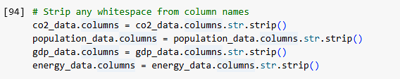
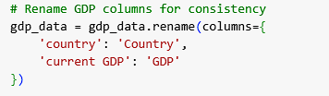
METHODOLOGY
Data Cleaning and Preprocessing:
Removed any leading or trailing whitespace from column names for consistency.
Standardized formats across datasets to ensure compatibility for merging and analysis.

Slide 7

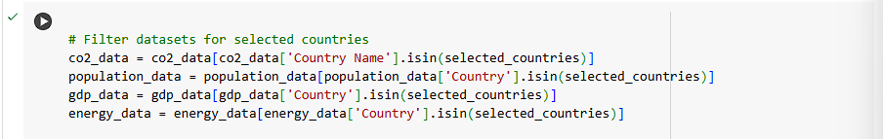
METHODOLOGY
Filtering Data:
Selected BRICS and G7 countries for targeted analysis.
Created subsets of datasets for the chosen countries to focus on relevant insights.

Slide 8
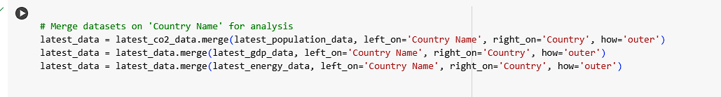
METHODOLOGY
Data Merging:
Combined the cleaned datasets based on common identifiers (country names).
Ensured that each country's CO2 emissions, population, GDP, and energy use data were aligned for comparative analysis.

Slide 9

METHODOLOGY
Data Transformation:
Converted GDP values to trillions of dollars for better readability and comparability across countries
Handling Missing Values:
Checked for missing values in the merged dataset and filled them with zeros to maintain consistency and prevent errors in subsequent analyses.

Slide 10
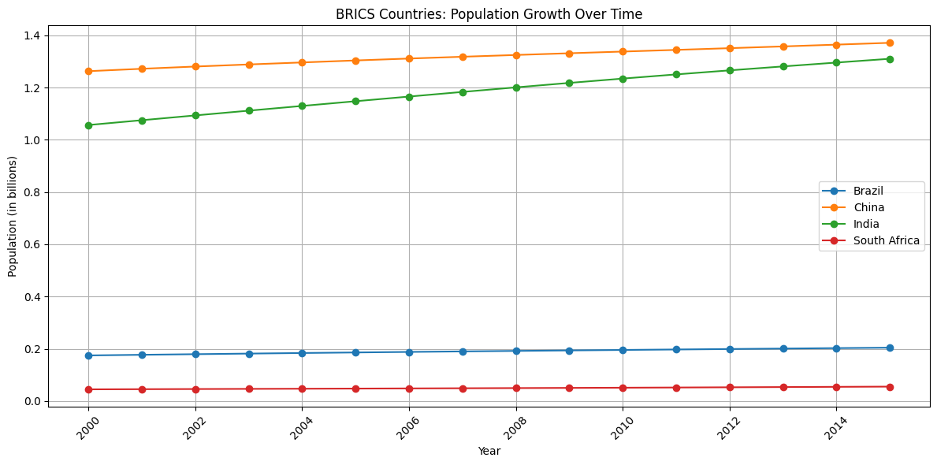
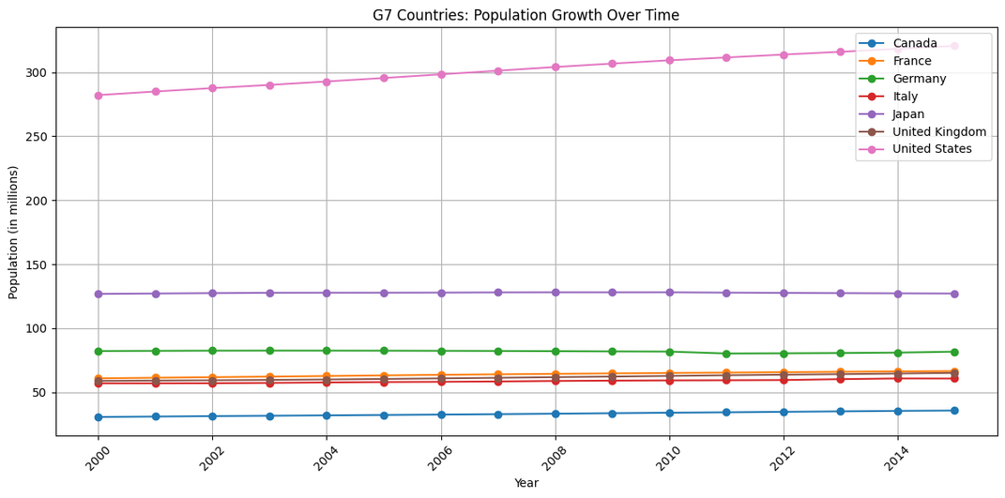
KEY FINDINGS WITH VISUALIZATION
Population Trends:
Observed significant population growth in BRICS countries, with India and China leading.
G7 countries showed more stable population trends, with slower growth rates.

Slide 11
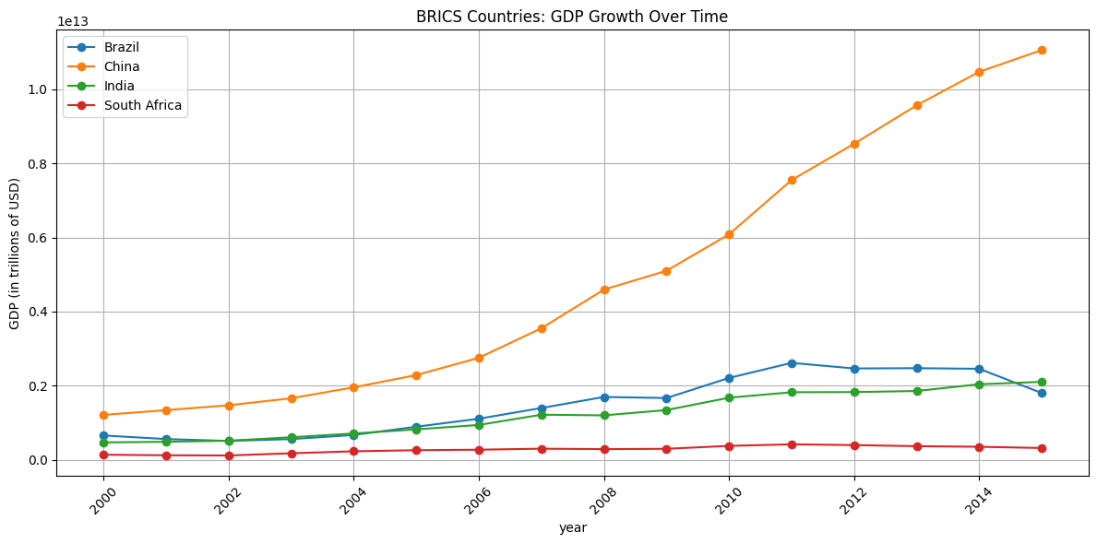
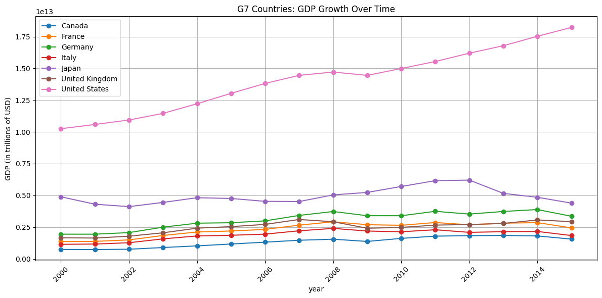
KEY FINDINGS WITH VISUALIZATION
GDP Growth:
BRICS countries experienced rapid GDP growth, especially China and India, compared to G7 nations.
G7 countries maintain higher GDP per capita, indicating a more developed economic status

Slide 12
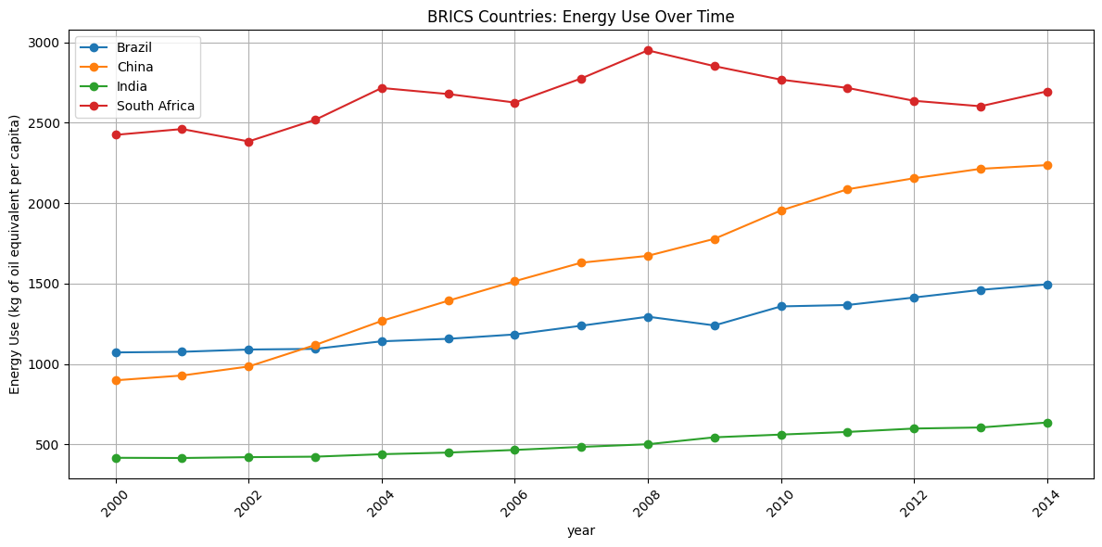
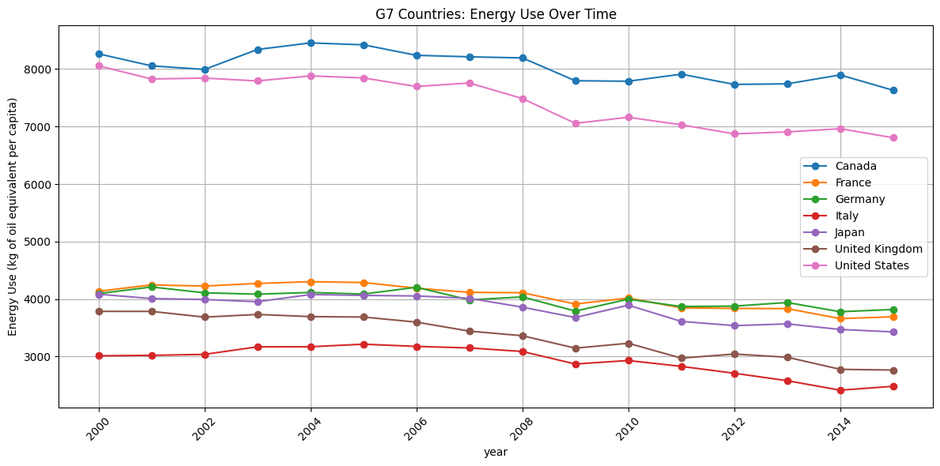
KEY FINDINGS WITH VISUALIZATION
Energy Consumption Patterns:
Energy use per capita is generally higher in G7 countries, reflecting advanced industrial activities.
BRICS countries are increasing their energy use as their economies grow.

Slide 13
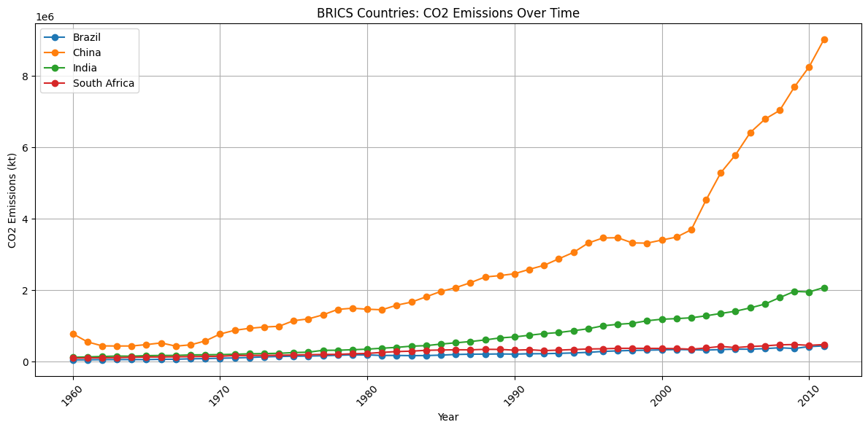
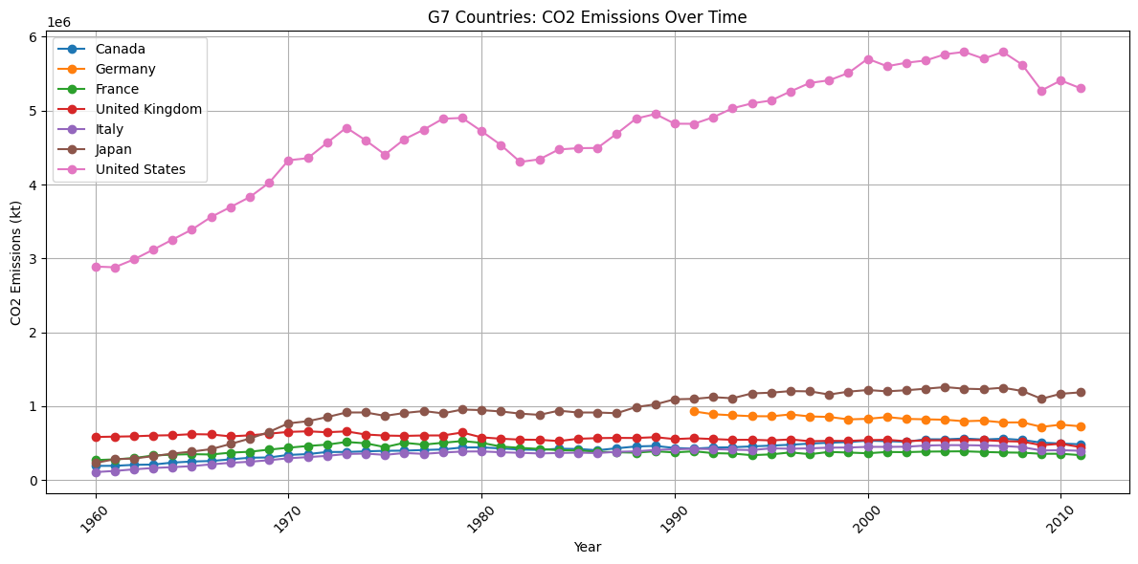
KEY FINDINGS WITH VISUALIZATION
CO2 Emissions Analysis:
Notable increase in CO2 emissions in BRICS nations correlating with economic growth.
G7 countries show more consistent emissions but have higher per capita emissions, raising concerns about environmental sustainability.

Slide 14
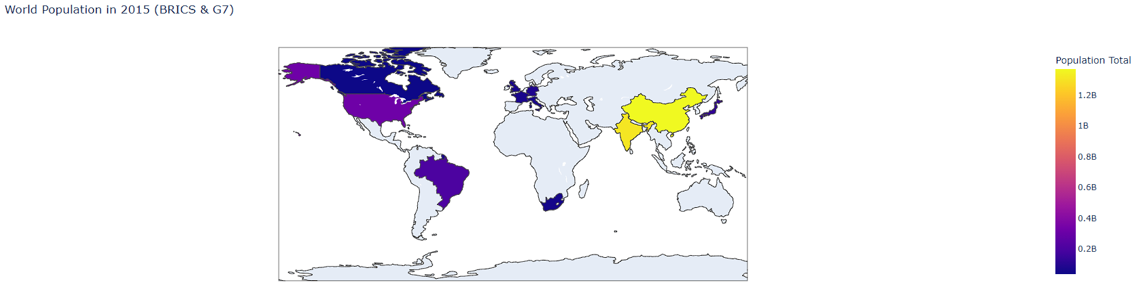
KEY FINDINGS WITH VISUALIZATION
Choropleth Map Visualizations
World Population 2015 (BRICS and G7 Countries)

Slide 15
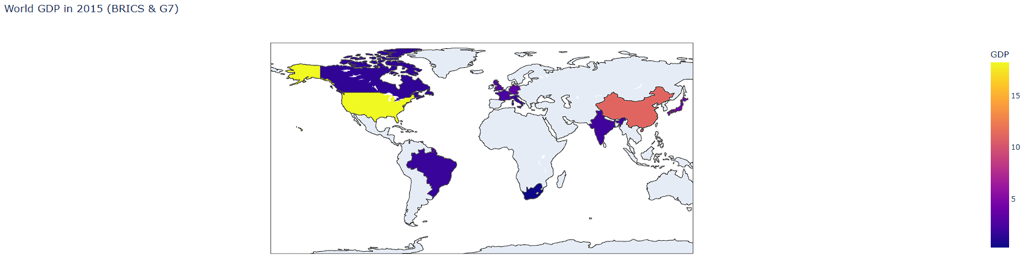
KEY FINDINGS WITH VISUALIZATION
Choropleth Map Visualizations
World GDP 2015 (BRICS and G7 Countries)

Slide 16
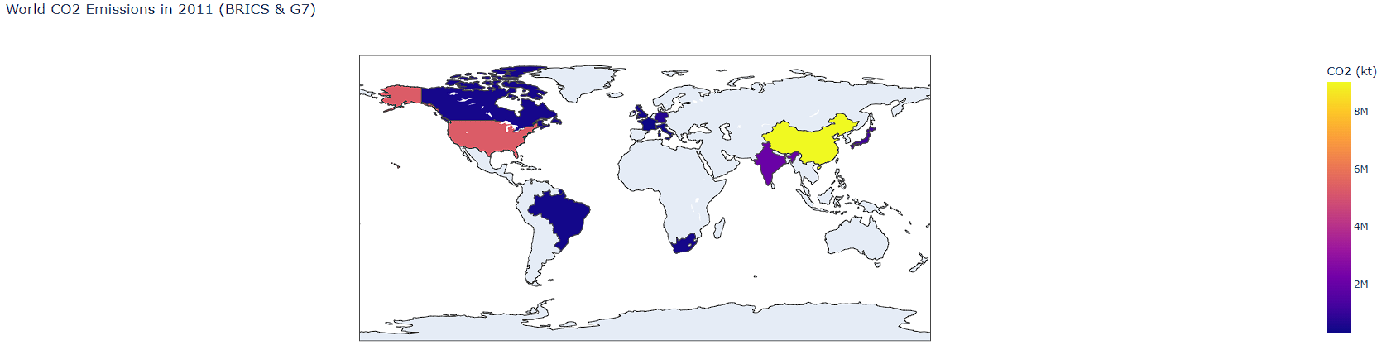
KEY FINDINGS WITH VISUALIZATION
Choropleth Map Visualizations
World CO2 EMISSIONS (BRICS and G7 Countries)

Slide 17
CONCLUSION
Summary of Findings:
Highlighted the interconnectedness of population growth, economic development, energy consumption, and CO2 emissions.
Identified the need for sustainable development strategies, particularly in rapidly growing economies.
Implications:
Emphasized the importance of transitioning to cleaner energy sources to reduce CO2 emissions.
Suggested that both BRICS and G7 countries should collaborate on policies aimed at sustainable development.

